Slide 1
Systematic reviews and meta-analyses
Jouko Miettunen, professor
Center for Life Course Health Research
University of Oulu
jouko.miettunen@oulu.fi
Oulu 26.11.2016

Slide 2
Systematic review
Clearly defined research question, aim to include all studies meeting the inclusion criteria
Methods should be replicable
A systematic search, which is likely to be found in all studies that meet the criteria
Assess the reliability of the study and potential biases
A systematic presentation of the results
Systematic synthesis of the characteristics and findings of the studies
Can begin as a systematic review, on can decide later if it is going to be a meta-analysis

Slide 3
Meta-analyses
Original studies are published increasingly, about 2 million medical articles per year
Impossible to keep up-to-date, there is a need for the syntheses
A meta-analysis combines statistically the results of previous studies
Most often used for clinical trials (e.g. drug or therapy)

Slide 4

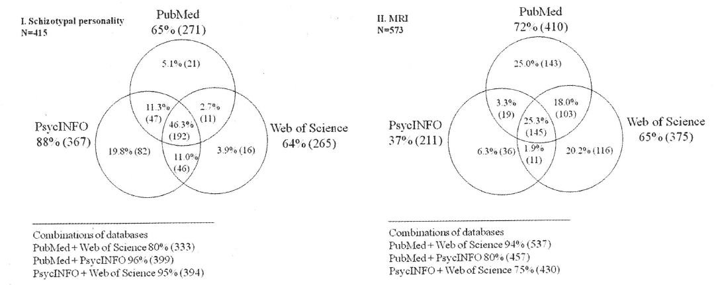
Nord J Psychiatry 2010; 64:181-8.

Slide 5
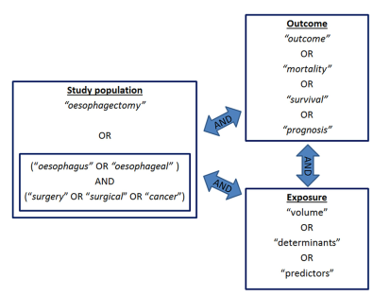
How to search?
Brusselaers 2015

Slide 6
Reporting guidelines
Moher et al. 2009, Liberati et al. 2009 (PRISMA)
  For clinical trials, may need to be edited for observational studies
Stroup et al. 2000 (MOOSE)
  Observational studies
Shea et al. 2007 (AMSTAR)
  Tool for evaluating the quality of the studies

Slide 7
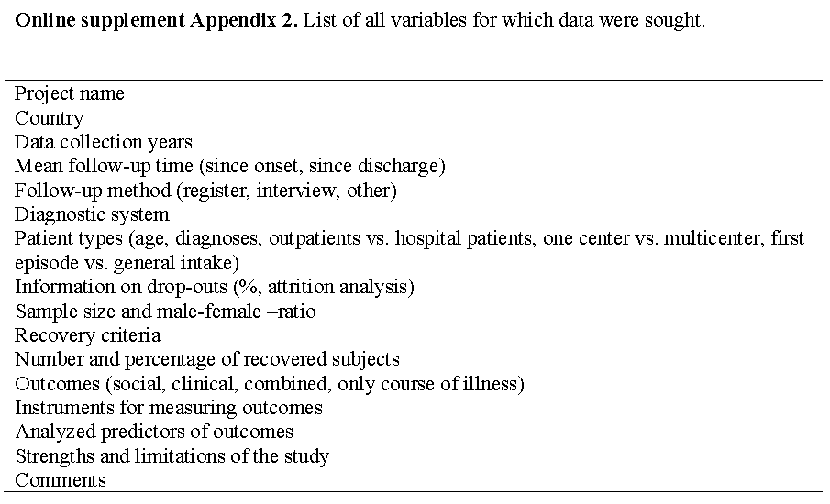
Collected variables
Form for the data collection
Jääskeläinen et al. 2013

Slide 8
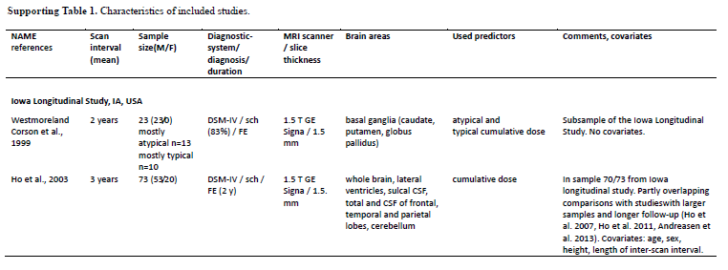
Literature table
All studies and essential data included
Huhtaniska et al. Manuscript.

Slide 9
Sources of bias
Publication bias is estimated with a funnel plot
It is assumed that the most accurate (and the largest) studies give average results, the smaller studies should be on both sides of the average
"Trim and fill", "Fail -safe" N
Rosenberg. Evolution 2005;59: 464-8

Slide 10
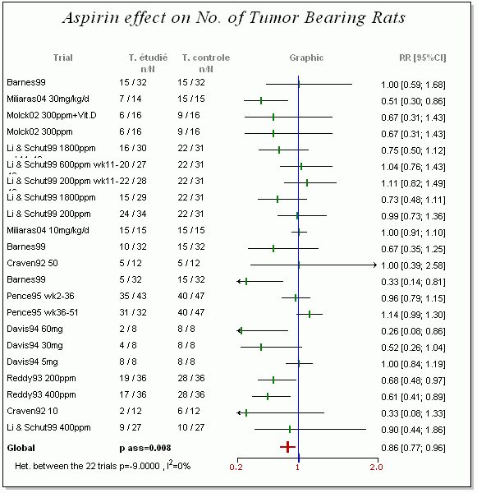

Slide 11
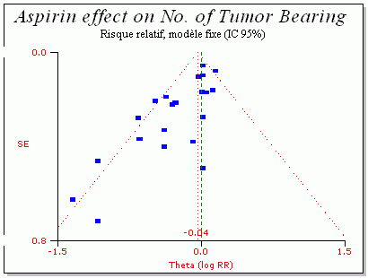
Funnel Plot
Corpet & Pierre. Eur J Cancer 2005 (http://corpet.free.fr/MAaspirin.html)

Slide 12
Trim and Fill
Can be used to correct for publication bias

Slide 13
Pooling the studies
The most important thing when combining studies is the magnitude and direction of effect (effect size), not statistical significance
Are the earlier results similar or not?
  homogeneity/heterogeneity
Choosing the result (outcome) if duplicate results?
  Sample size, follow-up length, mean of results?

Slide 14
Pooling the studies
Estimate the effect in each study
Effect size measures (categorical/continuous variables)
  Odds Ratio, Relative Risk, differences in percentages (absolute risk difference)
  Correlation coefficient (Pearson’s r etc.)
  Standardized mean difference
Unadjusted or adjusted effect
Sometimes it is only stated that the association was studied, but results were non-significant (N.S.)?
  First contact authors?
  if no reply, exclude the studies or set the effect to zero?
Kelley K & Preacher KJ. On Effect Size. Psychological Methods 2012; 17:137-52.
Notes:
NNT = 1 / absolute risk difference, kts PRISMA 24

Slide 15
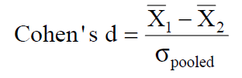
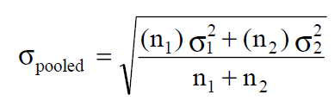
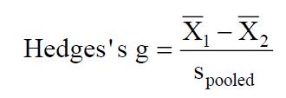
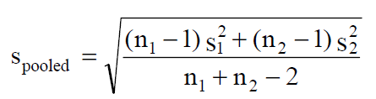
Cohen’s d
Standardized mean difference
  Also Hedges’s g, Glass’s Δ
(group A mean – group B mean) / pooled standard deviation
Notes:
Glassissa s on vain toisen ryhmän keskihajonta (s2), hedgesissä s:n kaavan alla lisäksi -2 (sopii pienille otoksille)

Slide 16
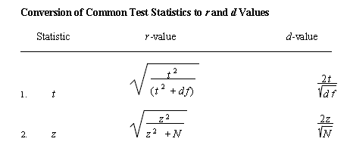
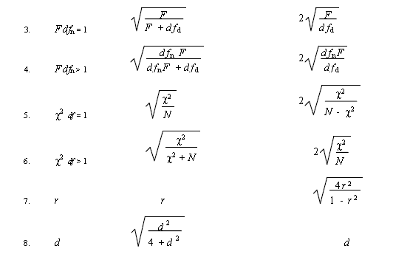
Different effect measures can be estimated from other statistics!
Rosenthal & Rubin. Psychological Bulletin 1986;99: 400-6.
Borenstein ym. Introduction to Meta-Analysis. Wiley, 2009.

Slide 17
Effect size estimates
 | Small | Moderate | Large | Very large
Cohen’s d | 0.2 | 0.5 | 0.8 | 1.3
Pearson’s r | 0.1 | 0.3 | 0.5 | 0.7
Odds Ratio | 1.5 | 2.5 | 4 | 10
Difference in percentage* | 7 | 18 | 30 | 45
* Group difference in percentages, when percentages within 15-85%
Cohen. Psychol Bull 1992;112:155-9; Rosenthal. J Soc Serv Res 1996;21:37-59.

Slide 20
Weighting studies
Fixed effects method
  Assumption is that there is one true effect size and that all differences in observed effects are due to sampling error
    In observational studies this is in practice unlikely to be true
  In practice, the weighting is based on the sample size

Slide 21
Weighting studies
Random effects method
  Effect is expected to vary between studies and both between-study and within-studies variances are allowed
  Weighting is based partly on standard error (sample size), but if heterogeneous results, the weights differ less
  If heterogeneity low: fixed effect ≈ random effect
Possible useful, but subjective methods?
  Weighting with quality scores
  Bayesian meta-analysis
Notes:
Oma slide laatukriteereistä

Slide 22
Heterogeneity
Cochran’s Q
  Based on the Chi-square test
  Depends on number of studies
Currently recommended to use a variation:
I² = (Q-df)/Q*100%
  df = number of studies - 1
  25% low, 50% moderate and 75% high heterogeneity
  Interpretation: “what proportion of the total variation across studies is beyond chance”
If small number of studies both methods lack power
Cochran. Biometrics 1954;10:101-29; Higgins & Thompson. Stat Med 2002;21:1539-58; Ioannidis et al. BMJ 2007;335:914-6.

Slide 23
Meta-regression
How study characteristics explain heterogeneity in effect size measures?
Continuous or categorical variables
Variables are related to studies not to individuals
  Proportion of men
  Mean age of the sample
  Country
  Research methods (e.g. instruments)
  Quality of research
  Study collection period (or year of publication)
  Patient groups
  Length of the follow-up

Slide 24
Meta-regression
Statistical test for the effect of background factor on heterogeneity (t or z- test)
Does not adjust the original result
As an alternative to meta-regression is to examine the direct effect of covariate on the effect
  Then the research question is different and the data is in a different format (e.g. the effects are collected by gender or data on effect of gender on outcome is collected)

Slide 25

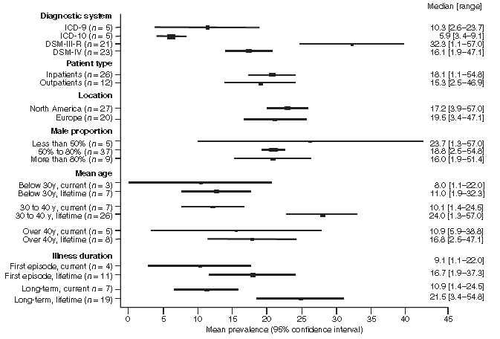
p<0.001
p=0.01
(lifetime)
Acta Psychiatr Scand 2009; 120: 85-96.

Slide 26
”network meta-analysis”
To explore a question which has not been directly investigated in original studies
E.g. combining studies with different drugs compared to placebo, so that the drugs are actually compared to each other

Slide 27

Comparative Effectiveness of First-Line Medications for Primary Open-Angle Glaucoma
TOPIC: Primary open-angle glaucoma (POAG) is a highly prevalent condition worldwide and the most common cause of irreversible sight loss. The objective is to assess the comparative effectiveness of first-line medical treatments in patients with POAG or ocular hypertension through a systematic review and network meta-analysis, and to provide relative rankings of these treatments.
METHODS: We included randomized controlled trials (RCTs) that compared a single active topical medication with no treatment/placebo or another single topical medication. We searched CENTRAL, MEDLINE, EMBASE, and the Food and Drug Administration's website. Two individuals independently assessed trial eligibility, abstracted data, and assessed the risk of bias. We performed Bayesian network meta-analyses.
RESULTS: We included 114 RCTs with data from 20 275 participants. The overall risk of bias of the included trials is mixed. The mean reductions (95% credible intervals) in IOP in millimeters of mercury at 3 months ordered from the most to least effective drugs were as follows: bimatoprost 5.61 (4.94; 6.29), latanoprost 4.85 (4.24; 5.46), travoprost 4.83 (4.12; 5.54), levobunolol 4.51 (3.85; 5.24), tafluprost 4.37 (2.94; 5.83), timolol 3.70 (3.16; 4.24), brimonidine 3.59 (2.89; 4.29), carteolol 3.44 (2.42; 4.46), levobetaxolol 2.56 (1.52; 3.62), apraclonidine 2.52 (0.94; 4.11), dorzolamide 2.49 (1.85; 3.13), brinzolamide 2.42 (1.62; 3.23), betaxolol 2.24 (1.59; 2.88), and unoprostone 1.91 (1.15; 2.67).
CONCLUSIONS: All active first-line drugs are effective compared with placebo in reducing IOP at 3 months. Bimatoprost, latanoprost, and travoprost are among the most efficacious drugs, although the within-class differences were small and may not be clinically meaningful. All factors, including adverse effects, patient preferences, and cost, should be considered in selecting a drug for a given patient.
Li T ym. Opthalmology 2015, in press.

Slide 28

Comparative Effectiveness of First-Line Medications for Primary Open-Angle Glaucoma
Li T ym. Opthalmology 2015, in press.

Slide 29
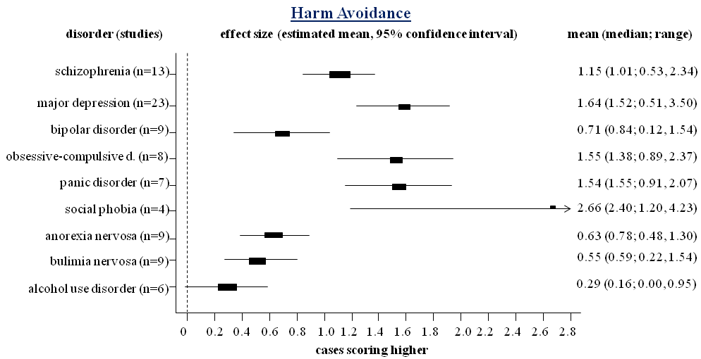
Meta-analysis of temperament traits in case-control studies in different psychiatric disorders
Tci dg meta esim
Miettunen & Raevuori. Compr Psychiatry 2012
Notes:
In HA, individuals with eating disorders (anorexia nervosa d= 0.63, bulimia nervosa d = 0.55) and alcohol use disorder (d = 0.29) had significantly lower scores compared with all other disorders (d’s between 0.71 and 2.66) except for bipolar disorder and for each others.

Slide 30
Statistical software
STATA
  http://www.biostat.jhsph.edu/~fdominic/teaching/bio656/software/meta.analysis.pdf (Sterne ym. 2001)
SPSS
  http://mason.gmu.edu/~dwilsonb/ma.html
SAS
  http://mason.gmu.edu/~dwilsonb/ma.html
R
  http://cran.r-project.org/web/views/MetaAnalysis.ht
Excel, MIX
  http://mix-for-meta-analysis.info
Comprehensive Meta-Analysis (CMA), Metawin, RevMan
http://www.meta-analysis.com/pages/comparisons.html

Slide 31
Other statistical methods
Meta-analyses of diagnostic tests and screens (Hasselblad & Hedges. Psychol Bull 1995;117:167-78)
Bayesian meta-analysis (Berry. Clin Trials 2009;6:28-41; Schmid. Eval Health Prof 2001;24:165-89; Sutton & Abrams. Stat Meth Med Res 2001; 10: 277–303; Warn et al. Stat Med 2002; 21: 1601-23.
Meta-analysis of factor analyses (Becker. Psychol Med 1996;1:341-53)
Meta-analysis of structural equation modeling (Cheung & Chan. Psychol Meth 2005;10:40.64)
Imputing missing data in meta-analyses of e.g. clinical trials (Higgins et al. Clin Trials 2008;5:225-39)
etc.

Slide 32

References
Notes:
Päivitä kirjallisuus

Slide 33
Blettner M et al. Traditional reviews, meta-analyses, and pooled analyses in epidemiology. Int J Epidemiology 1999; 28: 1-9.
Borenstein M et al. Introduction to Meta-Analysis. Wiley, 2009.
Cook DJ et al. (1995) Methodological guidelines for systematic reviews of randomized control trials in health care from the Potsdam consultation on meta-analysis. J Clin Epidemiol 48: 167-71.
Egger M et al. Systematic reviews in health care. 2. painos. Lontoo: BMJ Publishing Group, 2001.
Gerber S et al. Bibliographic study showed improving methodology of meta-analyses published in leading journals 1993-2002. J Clin Epidemiol 2007;60:773-80
Notes:
Cochranessa oli 134 sch ja 168 dep/anxi meta-analyysia

Slide 34
Glass GV et al. (eds.). Meta-analysis in Social Research. Beverly Hills, CA: Sage, 1981.
Guyatt GH et al. (2008) GRADE: An emerging consensus on rating quality of evidence and strength of recommendations. BMJ 336: 924–926.
Jadad A et al. (1996) Assessing the quality of reports of randomized clinical trials: is blinding necessary? Control Clin Trials 17:1–12.
Kelley K & Preacher KJ (2012) On effect size. Psychol Meth 17:137-52.
Leucht S et al. (2009). How to read and understand and use systematic reviews and meta-analyses. Acta Psychiatr Scand 119: 443–450.
Liberati A et al. The PRISMA statement for reporting systematic reviews and meta-analyses of studies that evaluate health care interventions: explanation and elaboration. PLoS Med 2009;6:e1000100.
Notes:
Cochranessa oli 134 sch ja 168 dep/anxi meta-analyysia

Slide 35
Moher D et al. Preferred reporting items for systematic reviews and meta-analyses: the PRISMA statement. PLoS Med 2009;6:e1000097
Sauerland S & Seiler CM. Role of systematic reviews and meta-analysis in evidence-based medicine. W J Surgery 2005;29:582-7.
Shea BJ et al. Development of AMSTAR: a measurement tool to assess the methodological quality of systematic reviews. BMC Medical Research Methodology 2007; 7:10
Sterne JAC (ed.). Meta-Analysis in Stata: An Updated Collection from the Stata Journal, 2009.
Stroup DF et al. Meta-analysis of observational studies in epidemiology. A proposal for reporting. JAMA 2000; 283:2008-12.
Sutton AJ et al. Methods for Meta-analysis in Medical Research. London: John Wiley, 2000.

Slide 36

KT283
jouko.miettunen@oulu.fi / www.joukomiettunen.net

